Slide 1
INDUSTRY SECTOR TYPES OF INDUSTRY SECTOR

Slide 2
Industry sector
types of industry sector & classification of industry,
General concepts of industry,
Research & development in industry and types of R&D.
Industry and academic joint research – Bridging the gap.
Technology Readiness levels (TRL) and
Manufacturing Readiness levels (MRL).

Slide 3
What Is an Industry?
An industry is a group of companies that are related based on their primary business activities.
In modern economies, there are dozens of industry classifications.
Industry classifications are typically grouped into larger categories called sectors.
Individual companies are generally classified into an industry based on their largest sources of revenue.
For example, while an automobile manufacturer might have a financing division that contributes 10% to the firm's overall revenues, the company would be classified in the automaker industry by most classification systems.
Cine Industry, etc.

Slide 4
Industries vs. Sectors
While both sectors and industries are classification systems used to group similar types of business operations, sectors are broader than industries.
For example, retail trade is a sector within the North American Industry Classification System (NAICS), and within that sector are industries, such as health and personal care stores, clothing stores, and shoe stores.

Slide 5

is that department is a part, portion, or subdivision while ministry is government department, at the administrative level normally headed by a minister (or equivalent rank, eg secretary of state), who holds it as portfolio, especially in a constitutional monarchy, but also as a polity.

Slide 6
The International Labour Organization (ILO) is devoted to promoting social justice and internationally recognized human and labour rights, pursuing its founding mission that social justice is essential to universal and lasting peace.
Industries and sectors
Agriculture; plantations;other rural sectors
Basic Metal Production
Chemical industries
Commerce
Construction
Education
Financial services; professional services
Food; drink; tobacco

Slide 7
Forestry; wood; pulp and paper
Health services
Hotels; tourism; catering
Mining (coal; other mining)
Mechanical and electrical engineering
Media; culture; graphical
Oil and gas production; oil refining
Postal and telecommunications services
Public service
Shipping; ports; fisheries; inland waterways
Textiles; clothing; leather; footwear
Transport (including civil aviation; railways; road transport)

Slide 8
Transport equipment manufacturing
Utilities (water; gas; electricity) :
Utilities (water, electricity and gas) are essential services that play a vital role in economic and social development.
Quality utilities are a prerequisite for effective poverty eradication
Transport is a crucial driver of social and economic development.
Investments and gross domestic product expenditure in this sector are important, as it ensures mobility and trade.
Transport subsectors - road, railways and civil aviation - employ many workers in a wide range of job categories

Slide 9
Public service sector
The State is the largest or the single most important employer in almost all countries.
The public service personnel comprise persons employed by public authorities at central, regional and local levels and include both civil servants and public employees.
Public authorities must provide high-quality services to their citizens and decent work for their workers.
The optimal way to achieve sustainable national development and poverty alleviation is to promote good governance and transparency through effective social dialogue in the public service.

Slide 10
Industry: Research and Development of Industries
Industry is directly affected by science and technology devel­opments. The foremost concern of industry is to produce goods efficiently, saving on costs, time and energy.
S&T research is thus indispensable to industrial development, discovering, as it does,
new processes appropriate to local resources and requirements,
adapting processes to changing conditions and needs,
all directed towards better utilisation of resources.
Industrial units of the defence group, which are in the public sector, spend maximum on R&D, followed by electrical and electronics, metallurgical and chemicals
Also, expenditure per R&D unit, has been more in public sector industries, compared to corresponding units in the private sector.
The number of R&D personnel with engineering and technology background dominate in the industrial sector.

Slide 11
Major R&D Infrastructure:
In a developing country like India, it is inevitable that R&D activities be taken up on a large scale by the government.
However, the functioning of these organisations has been far from satisfactory.
A major reason for this has been the political system in which public sector R&D organisations have had to function.
Department of Scientific and Industrial Research: an important part of the Ministry of Science and Technology.
It encompasses the activities of the
Council of Scientific and Industrial Research (CSIR),
National Research Development Corporation (NRDC),
Central Electronic Limited (CEL) and
National Information System for Science & Technology (NISSAT)

Slide 12
In the Tenth Five Year Plan, the ongoing schemes of the Ninth Plan, viz., Research and Development by Industry (RDI), Programme Aimed at Technological Self-reliance (PATSER) and Scheme to Enhance the Efficacy of Transfer of Technology (SEETOT), including Asian and Pacific Centre for Transfer of Technology (APCTT), were merged into a single scheme, viz., Technology Promotion, Development and Utilisation (TPDU) Programmes.
The broad objectives of TPDU programmes :
to promote and support industry efforts towards R&D;
to encourage R&D system- industry cooperation;
to support industry for technology devel­opment, demonstration and absorption of imported technology;
to build indigenous capabilities for development and commercialisation of con­temporary products and processes of high impact;
to evaluate the status and performance of technology in selected sectors/areas; to facilitate effective transfer and management of technology;
to promote international technology trade including export of technology projects, services and technology-intensive products;
to promote and strengthen consultancy capabilities for domestic use and export requirements;
to support and use mechanisms, both national and international, towards transfer of technol­ogy, both within and outside the country;
and to generate endogenous capacities for the development and utilisation of digital information resources for providing inputs to scientific and industrial research in the country.

Slide 13
Types of R&D: There are three types of R&D.
#1 – Basic Research
Research of this objective is to get complete knowledge and understanding of one special subject, not a practical situation. This research is also called as pure or fundamental research. Basic research is a theoretical approach to any subject.
#2 – Applied Research
Research of this objective is to get complete knowledge and understanding of one special subject in a practical situation. This research is an inverse of basic research. This research is formulated to solve a practical problem.
#3 – Development Research
This Research is a combination of applied and basic research. This research will be implemented after getting knowledge and understanding of a specific task/subject from the basic and applied research.

Slide 14
Advantage
R&D has increased the productivity of goods and services manufactured/traded/supplied by an entity.
It has increased the income or profitability of an entity after analysis of costing such as manufacturing/selling/general expenses which expenses can be reduced to a certain level so that income or profitability can be increased.
Governments of some countries motivate to industries/entities for Research and development of their goods and supplies and also provide taxes benefits.
Positive Research and development (R&D) is increased the goodwill of an entity’s product and services.
Gained new knowledge and understanding from research and development, an entity can start a new business plan and find some opportunity.
The company can increase the business volumes in the market after research of the present market scenario basis what are the expecting customers from the goods and services provided by the company. This will increase the revenue and profitability of the company.
If the company wants to borrow money then before providing documents to the lender, management should analysis the lender’s profile, future forecasting about changes in the rate of interest, which country’s economy impacting to the lender’s business, etc. and after gained all the relevant knowledge and understanding.
Positive R&D outcomes can increase the long term benefits on investments of the entity.
An entity can use available human resources at an optimum level.
It can control the risk such as Operational Risk, Management Risk, Financial risk and investing risk after analysis of the relevant vertical scenario.

Slide 15
Disadvantage
Research and development have increased the cost of the company. Its outcomes can be positive and negative.
Separate Manpower to be hired by the entity for doing R&D and this will increase the cost of the company.
It is a very difficult process and highly experienced and well – qualified manpower is required to do the research and development (R&D).
It can produce artificial outcomes.
Failure in R&D will not be increased in sales volume and revenue as well.
Whether an Entity gets positive or negative outcomes Product cost to be increased by the R&D cost and increases in product prices can be decreased in sales volume.
Limitation of Research and Development
Outcomes/findings/results of research and development can be positive or negative and artificial too.
Selection of the type of R&D is very difficult until human resource can’t understand the current market scenario.
Company cost will be incurred on all type of R&D whether its outcomes are positive or negative.
The risk involved in these projects and the company should have sufficient budget to exposure the risk and timelines set by the team.
Sometimes research and development can be terminated in the mid because of changes in the political scenario, new competitors in the market or declined in the prices.

Slide 16
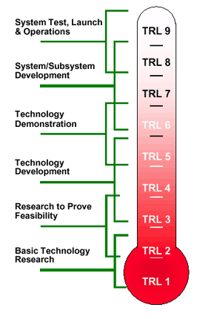
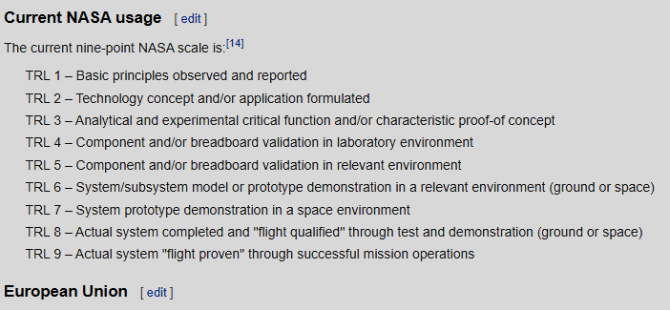
Technology readiness levels (TRLs) are a method for estimating the maturity of technologies during the acquisition phase of a program, developed at NASA during the 1970s.

Slide 17
The manufacturing readiness level (MRL) is a measure developed by the United States Department of Defense (DOD) to assess the maturity of manufacturing readiness, similar to how technology readiness levels (TRL) are used for technology readiness.
MRLs are assessed to:
define the current level of manufacturing maturity
identify maturity shortfalls and associated costs and risks
provide the basis for manufacturing maturation and risk management
Immature manufacturing processes may lead to the following problems:
Inattention to manufacturing during planning and design
Poor supplier management planning
Lack of workforce knowledge and skills
Assessing technology readiness levels does leave some major transition questions unanswered:
Is the level of performance reproducible?
What will these cost in production?
Can these be made in a production environment by someone without a PhD?
Are key materials and components available?

Slide 18
